Slide 1


Slide 2
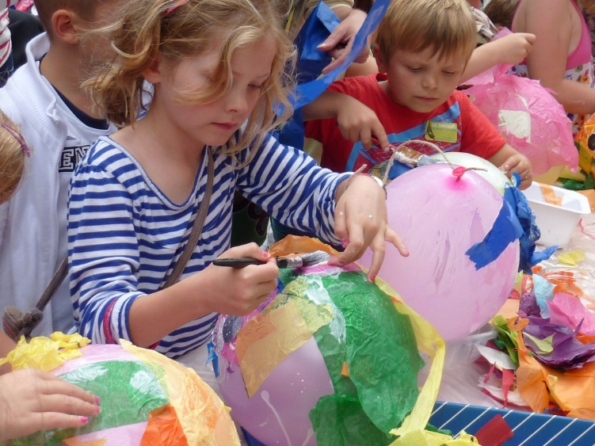


Problem
Lack of a platform for artwork of unknown talented Artists.
Lack of an one stop online portal where every kind of hand made & hand painted artefacts in affordable prices are available.
Umm…
The Seventh Sense Art

Slide 3
Solution
‘The Seventh Sense’
An online market place for unknown talented artists and their mind blowing artwork.
A worldwide online web portal where every kind of hand made & hand painted artefact is available for art lovers.
The Seventh Sense Art

Slide 4
What Are We Trying To Do?
The Seventh Sense Art

Slide 5
Unknown Artist
Unknown Artist
Unknown Artist
Unknown Artist
THE SEVENTH SENSE
(Online Platform)
Consumers
(Hunters, Archt. & I.D, Collectors & Licensees)
The Seventh Sense Art

Slide 6
Existing Systems
The Seventh Sense Art

Slide 7






Best College Art
Local Art Galleries
Pepper Fry
Saatchi Art Gallery
Art Zolo
U Gallery
The Seventh Sense Art

Slide 8
Why Are We Better?
The Seventh Sense Art

Slide 9
Things which make us different and better are :
Platform to Unrecognised artists
Categorization
Delivering Ideas
Global availability of products
Affordable prices
COD, Easy Return Policy & Home Delivery
The Seventh Sense Art

Slide 10
Problem Analysis
The Seventh Sense Art

Slide 11
Product definition
The seventh sense is basically an online art gallery from where the art lovers(users) and view and buy (only registered users)
every kind of hand made and hand painted artefact or artwork from eight different categories.
We make artefact on order too as per customers taste & demand.
The Seventh Sense Art

Slide 12


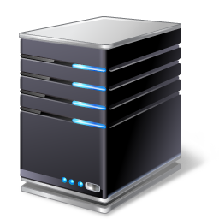


Feasibility Analysis
It is a simple e-commerce website so it is feasible to make this but I needed following things to do so.
Computer Internet Connection IDE to code FTP client Server
The Seventh Sense Art

Slide 13
Software Requirement Analysis
The Seventh Sense Art

Slide 14








I Required The Following Things?
The Seventh Sense Art

Slide 15
Design
The Seventh Sense Art

Slide 16
Tables
User-id | Username | email | password | activation | address | bank-details
Primary Key Auto increment | Unique Username | Unique Email | 128-bit Encryption | To check Id email is owned by user | For home Delivery | For artists To pay for their products
Users table
Pid | Pname | Pprice | Partist | Pinfo | Ptype | sold | location
Primary Key Auto increment | Product name | Product Price | Foreign key (user-id of Logged in user) | Description | Category Of product | Product sold or not | Location of image of product
Products table
The Seventh Sense Art

Slide 17
Tables
Id | Authenticator1 | f2authenticator2 | User-id | Expires
Primary Key Auto increment | Value of authenticator1 | Value of f2 of authenticator2 | Foreign key (user-id) | To check Id email is owned by user
Remember me Table
Id | User-id | rkey | Time | Status
Primary Key Auto increment | Foreign key (user-id) | Unique(random) Activation key | Current time | To check if key is already used or not
Forgot password Table
The Seventh Sense Art

Slide 18
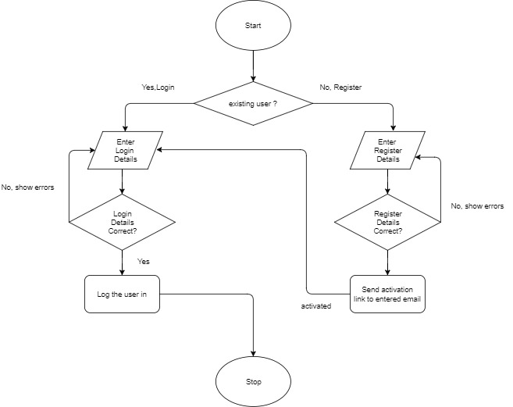
Login Flowchart
The Seventh Sense Art

Slide 19
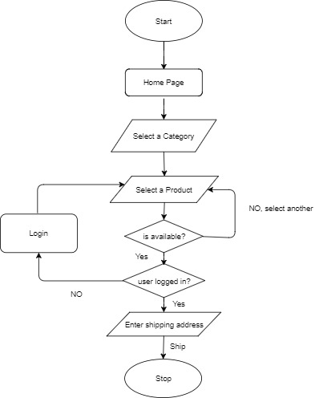
Buy Process Flowcharts
The Seventh Sense Art

Slide 20
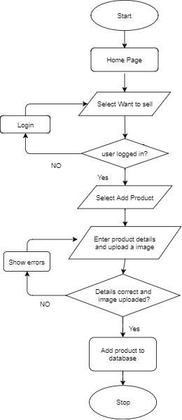
Add Product Flowcharts
The Seventh Sense Art

Slide 21
Implementation
The Seventh Sense Art

Slide 22
Implementation of the project :
I implemented this website using HTML, CSS, JavaScript, jQuery, Bootstrap, MySQL, php and Ajax.
Front End Development.
Back End Development.
The Seventh Sense Art

Slide 23
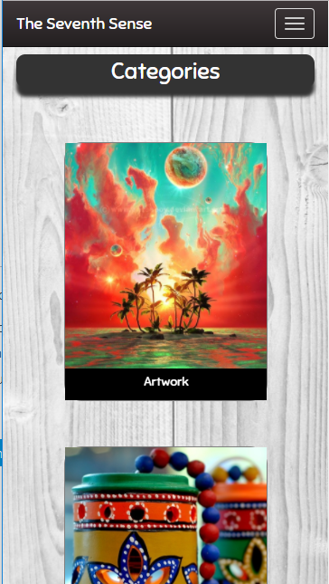
Place your screenshot here
Place your screenshot here
The Seventh Sense
on small screen devices.
Android View
iPhone View

Slide 24
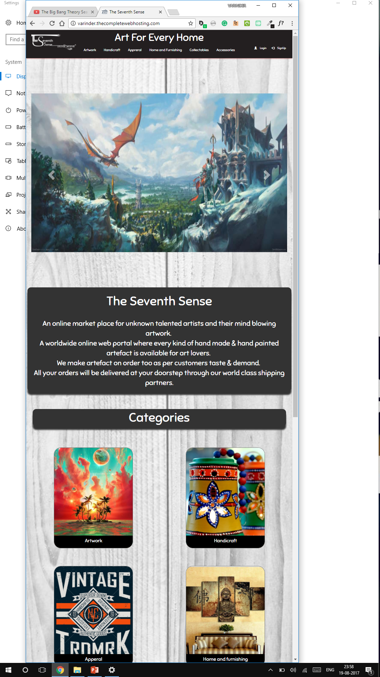
Tablet View
The Seventh Sense
on medium screen devices.
Place your screenshot here

Slide 25
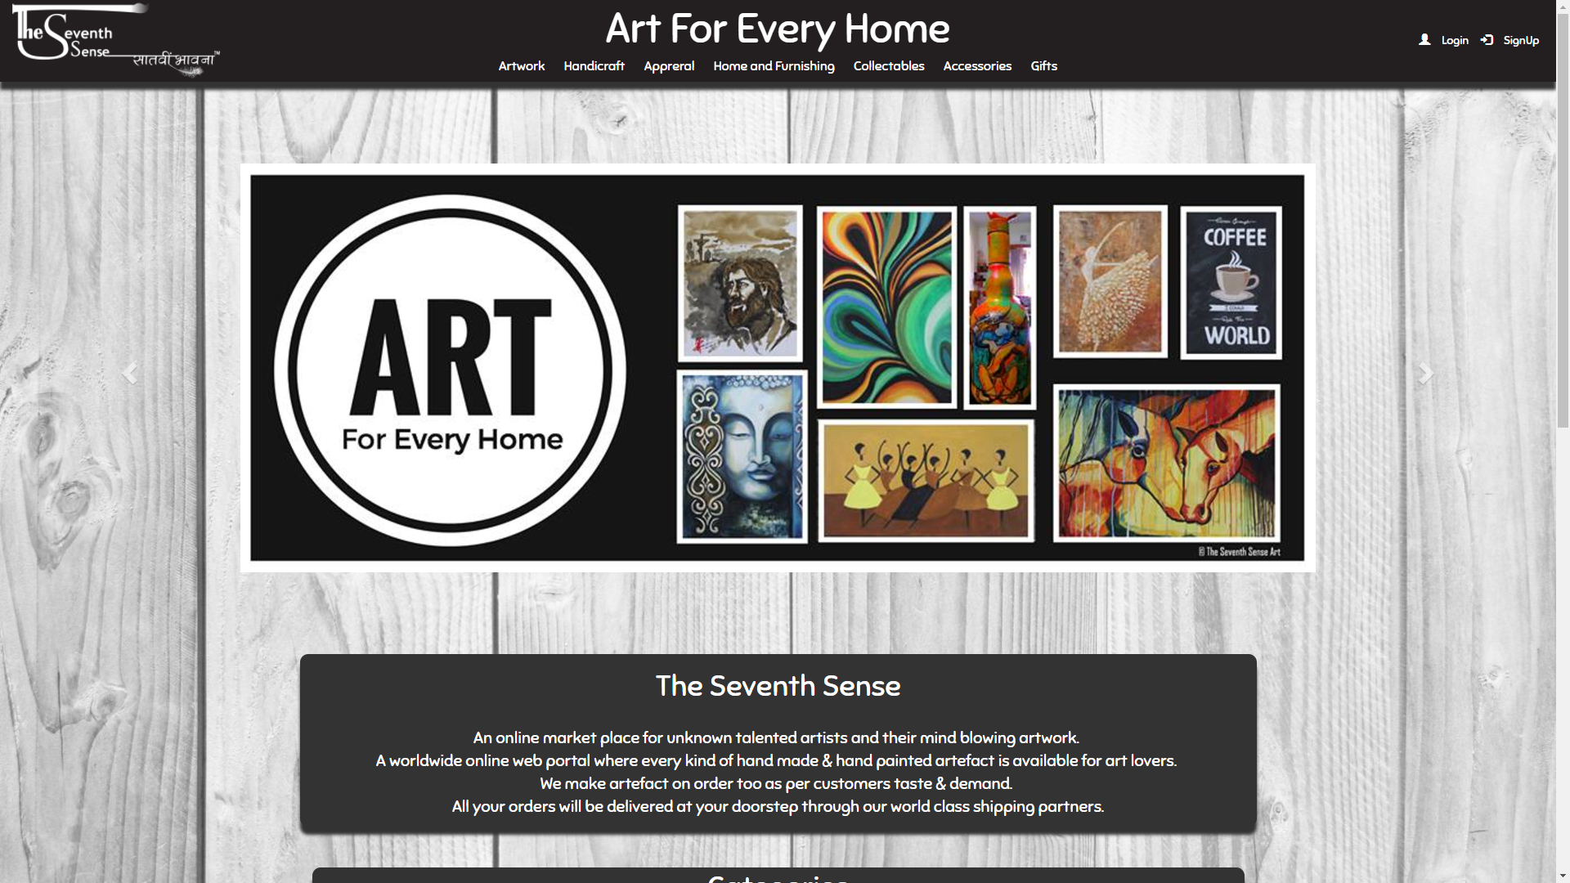
Desktop View
The Seventh Sense
on large screen devices.
Place your screenshot here

Slide 26
Testing
The Seventh Sense Art

Slide 27
Software testing is a process of executing a program or application with the intent of finding the software bugs.
Unit Testing
Integration Testing
System Testing
The Seventh Sense Art

Slide 28
Test Cases:
Register:
S. No. | Input | Output
1 | Leave some fields empty | Please enter the required details
2 | Enter invalid email | Please enter a valid email.
3 | Enter invalid password | Your password must contain at least one capital letter, one small letter, one number and one special character.
4 | Enter correct details | Registration successful we have sent an activation link to your email id.

Slide 29
Login:
S. No. | Input | Output
1 | Enter wrong email. Example: ‘XYZ’ | Incorrect email or password
2 | Enter wrong password. Example: ‘XYZ’ | Incorrect email or password
3 | Leave password field empty | Please enter password.
4 | Enter correct username and password Example: Username= varinder@gmail.com Password=password | Login Successful
The Seventh Sense Art

Slide 30
Add Product:
S. No. | Input | Output
1 | Leave some detail input fields empty. | All fields are mandatory.
2 | Do not choose a category. | Please select a category.
3 | Do not upload image of product. | Please upload image of product.
4 | Enter all details and upload image of product correctly. | Your product is added to our database successfully.
The Seventh Sense Art

Slide 31
Remaining Areas of Concern
The Seventh Sense Art

Slide 32
Remaining Areas of Concern.
A better security for securing the information of users.
Better Database management.
More functionalities
Algorithm to filter out irrelevant products from database.

Slide 33
Bibliography
The Seventh Sense Art

Slide 34
Websites:
http://www.w3schools.com/php/
https://www.udemy.com/complete-web-development-course/learn/v4/overview
https://stackoverflow.com/
http://twitterbootstrap3navbars.w3masters.nl/
https://loading.io/
The Seventh Sense Art

Slide 35
Thank You!

Slide 36
Place your screenshot here
Home Page

Slide 37
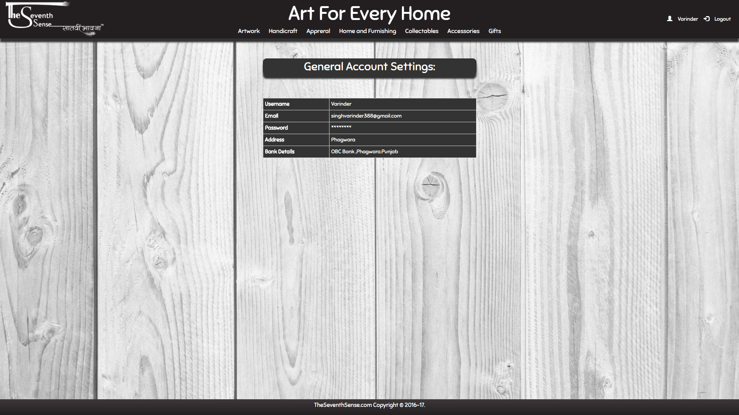
Place your screenshot here
Profile
Page

Slide 38
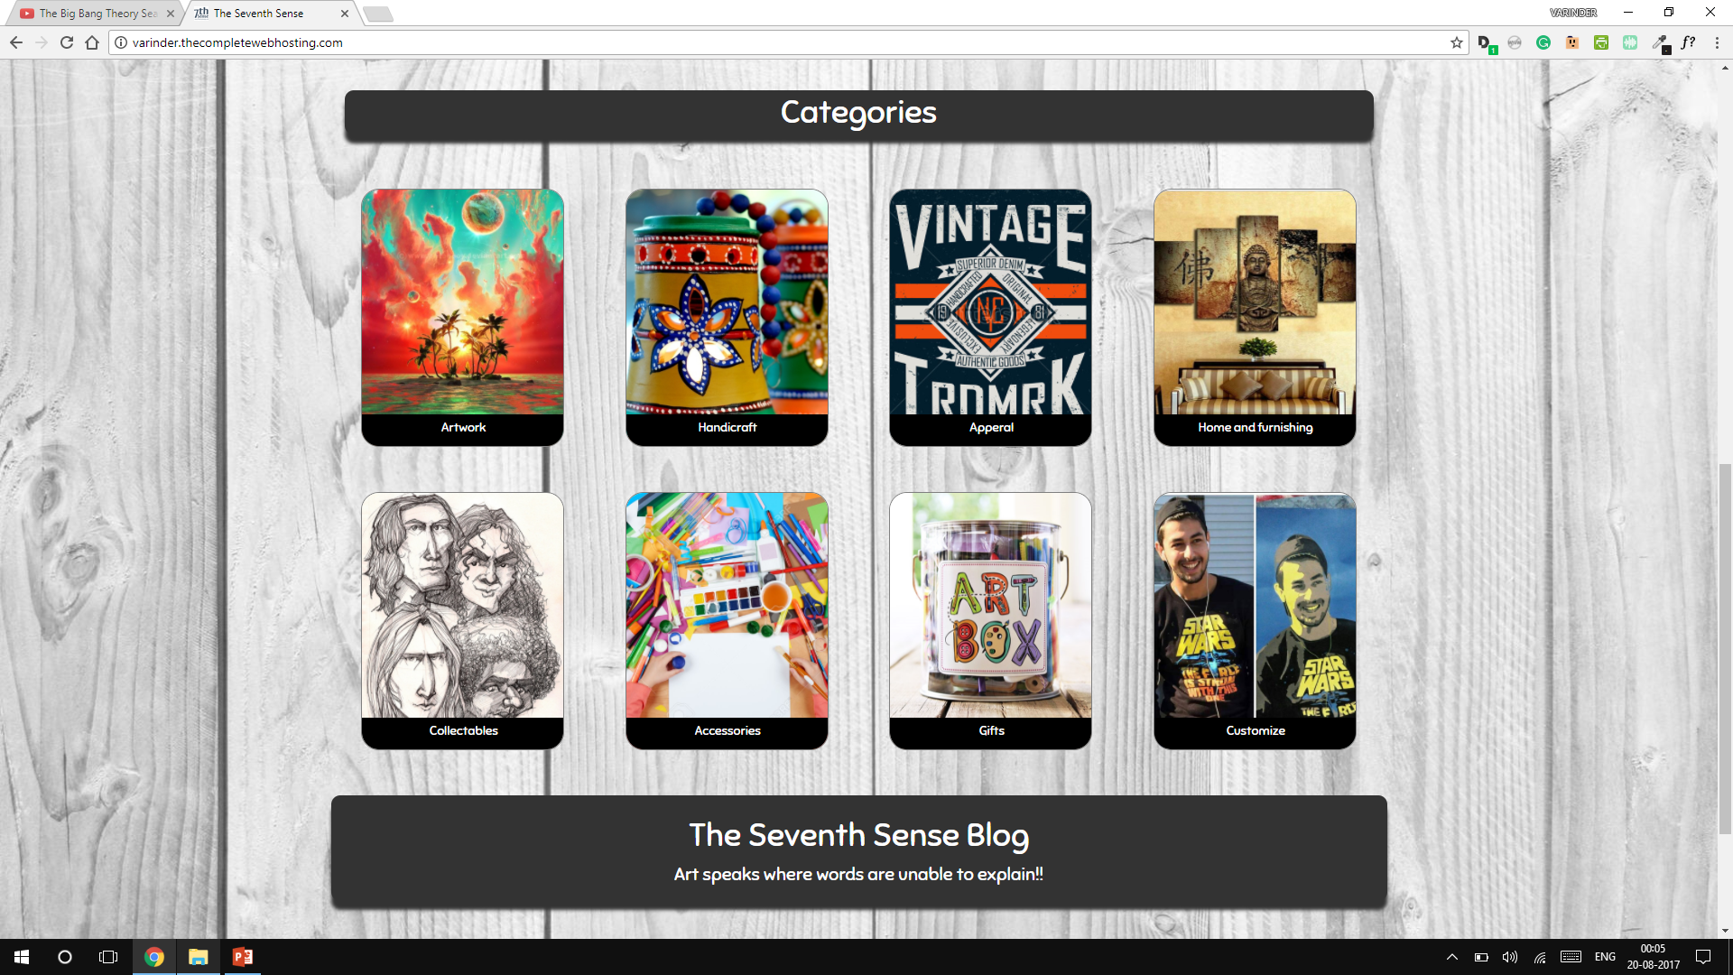
Place your screenshot here
Categories

Slide 39
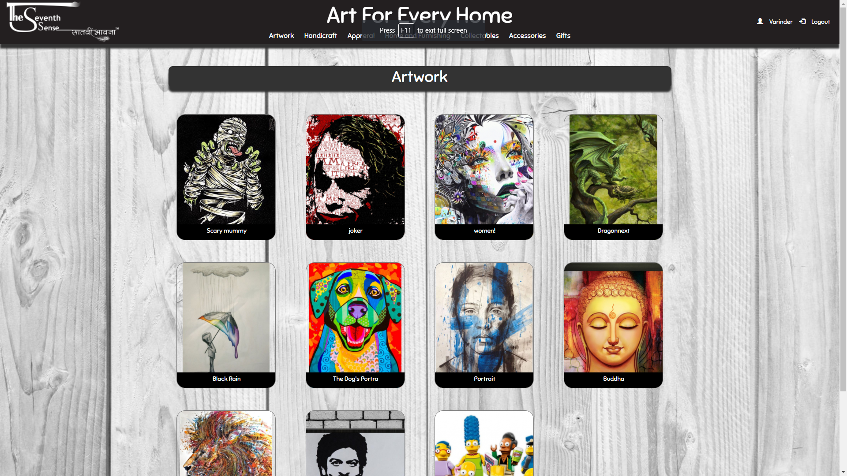
Place your screenshot here
Artwork
Page

Slide 40
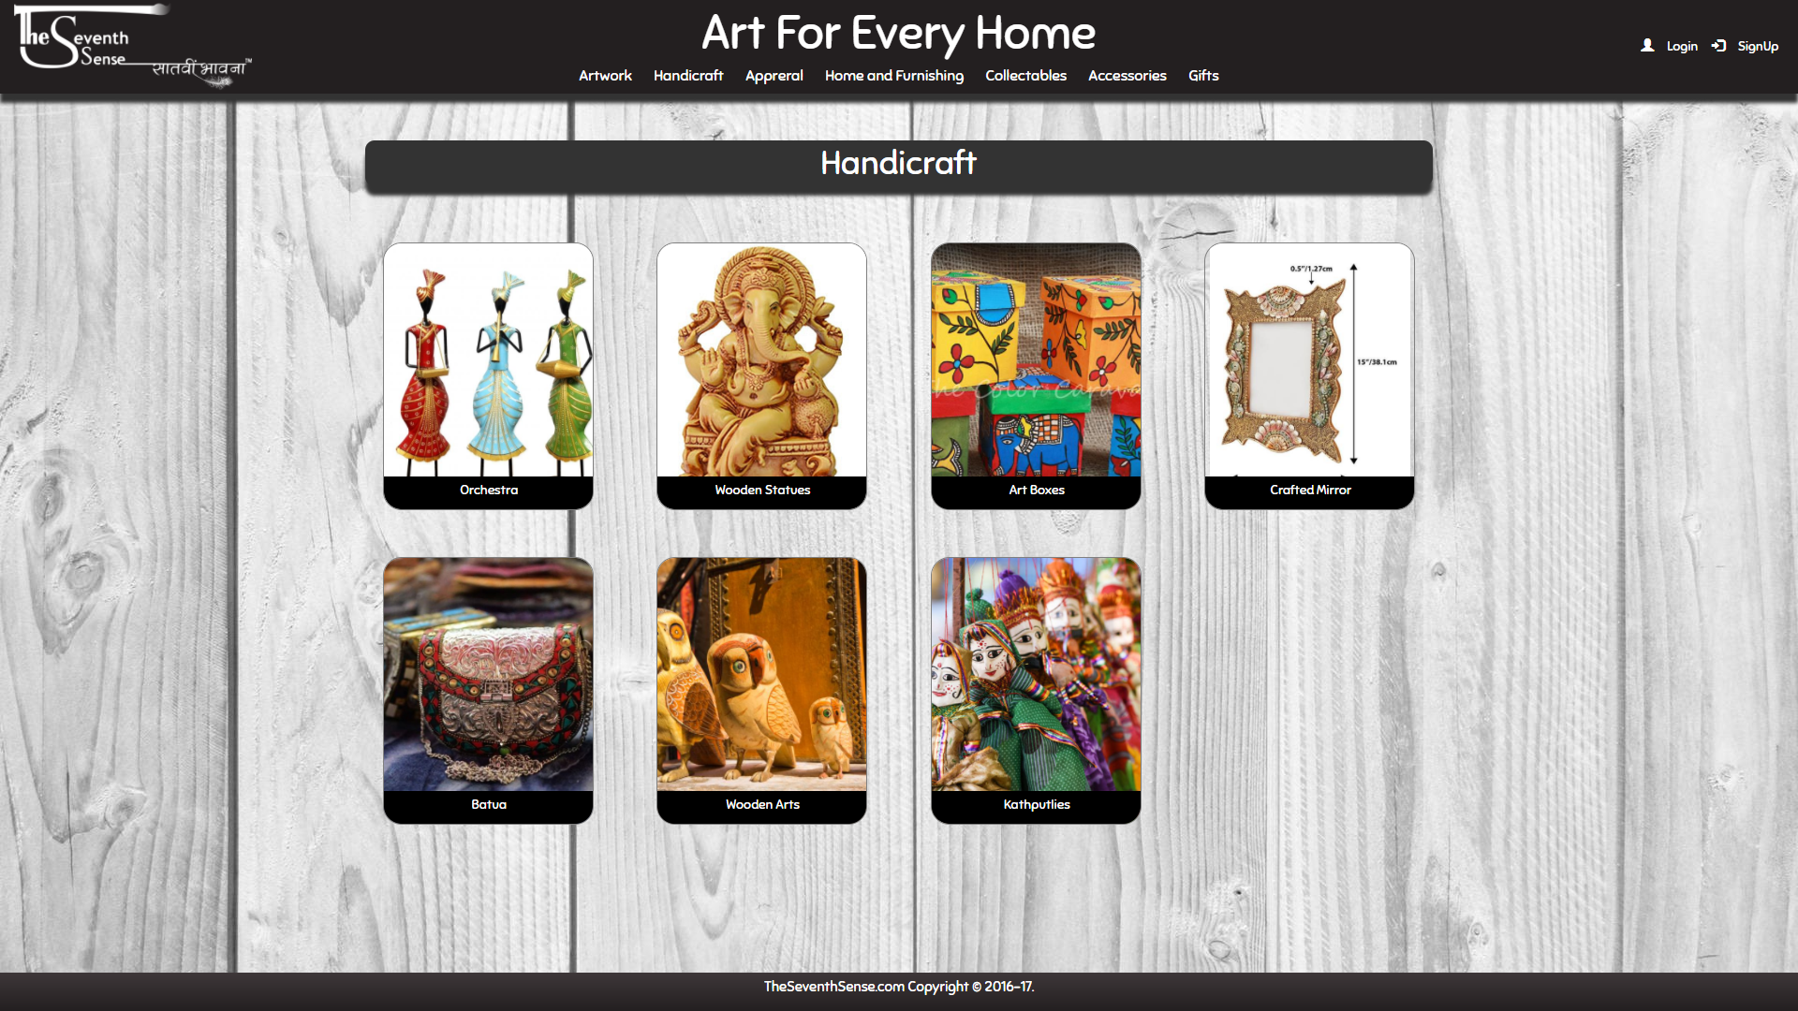
Place your screenshot here
Handicraft
Page

Slide 41
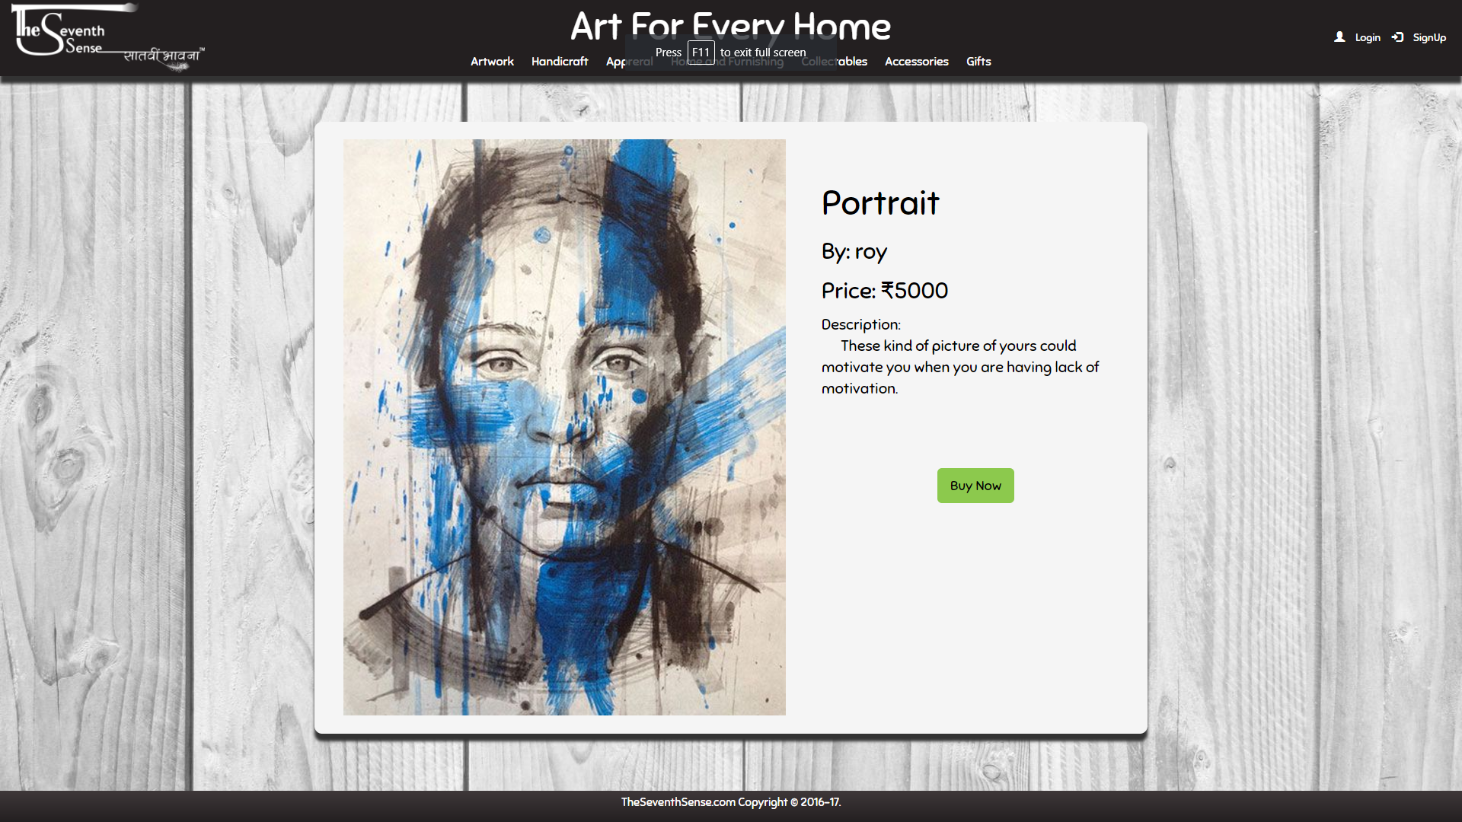
Place your screenshot here
Buy
Page

Slide 42
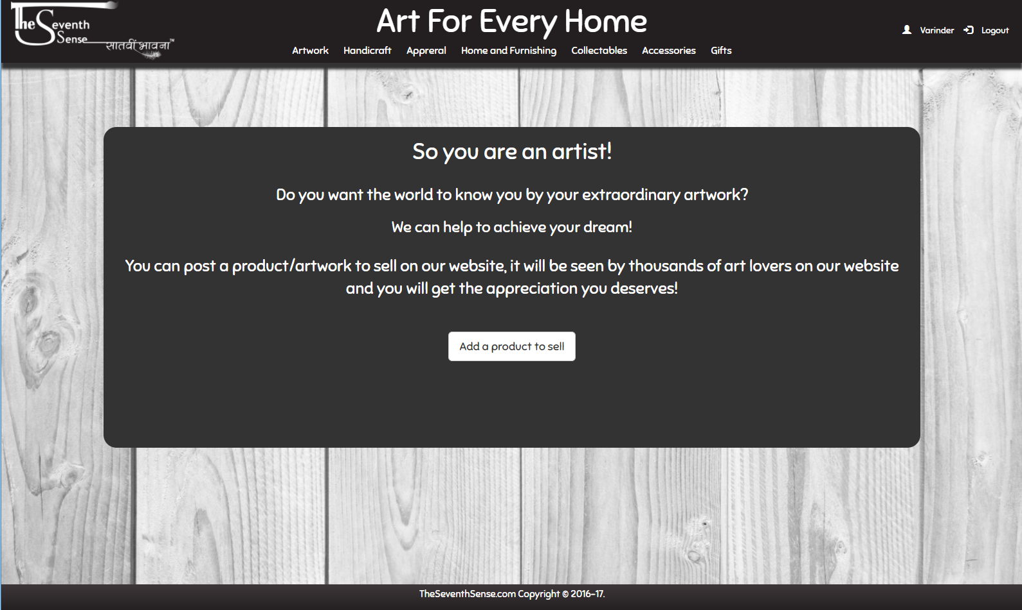
Place your screenshot here
Post
Product
To
Sell
Page

Slide 43
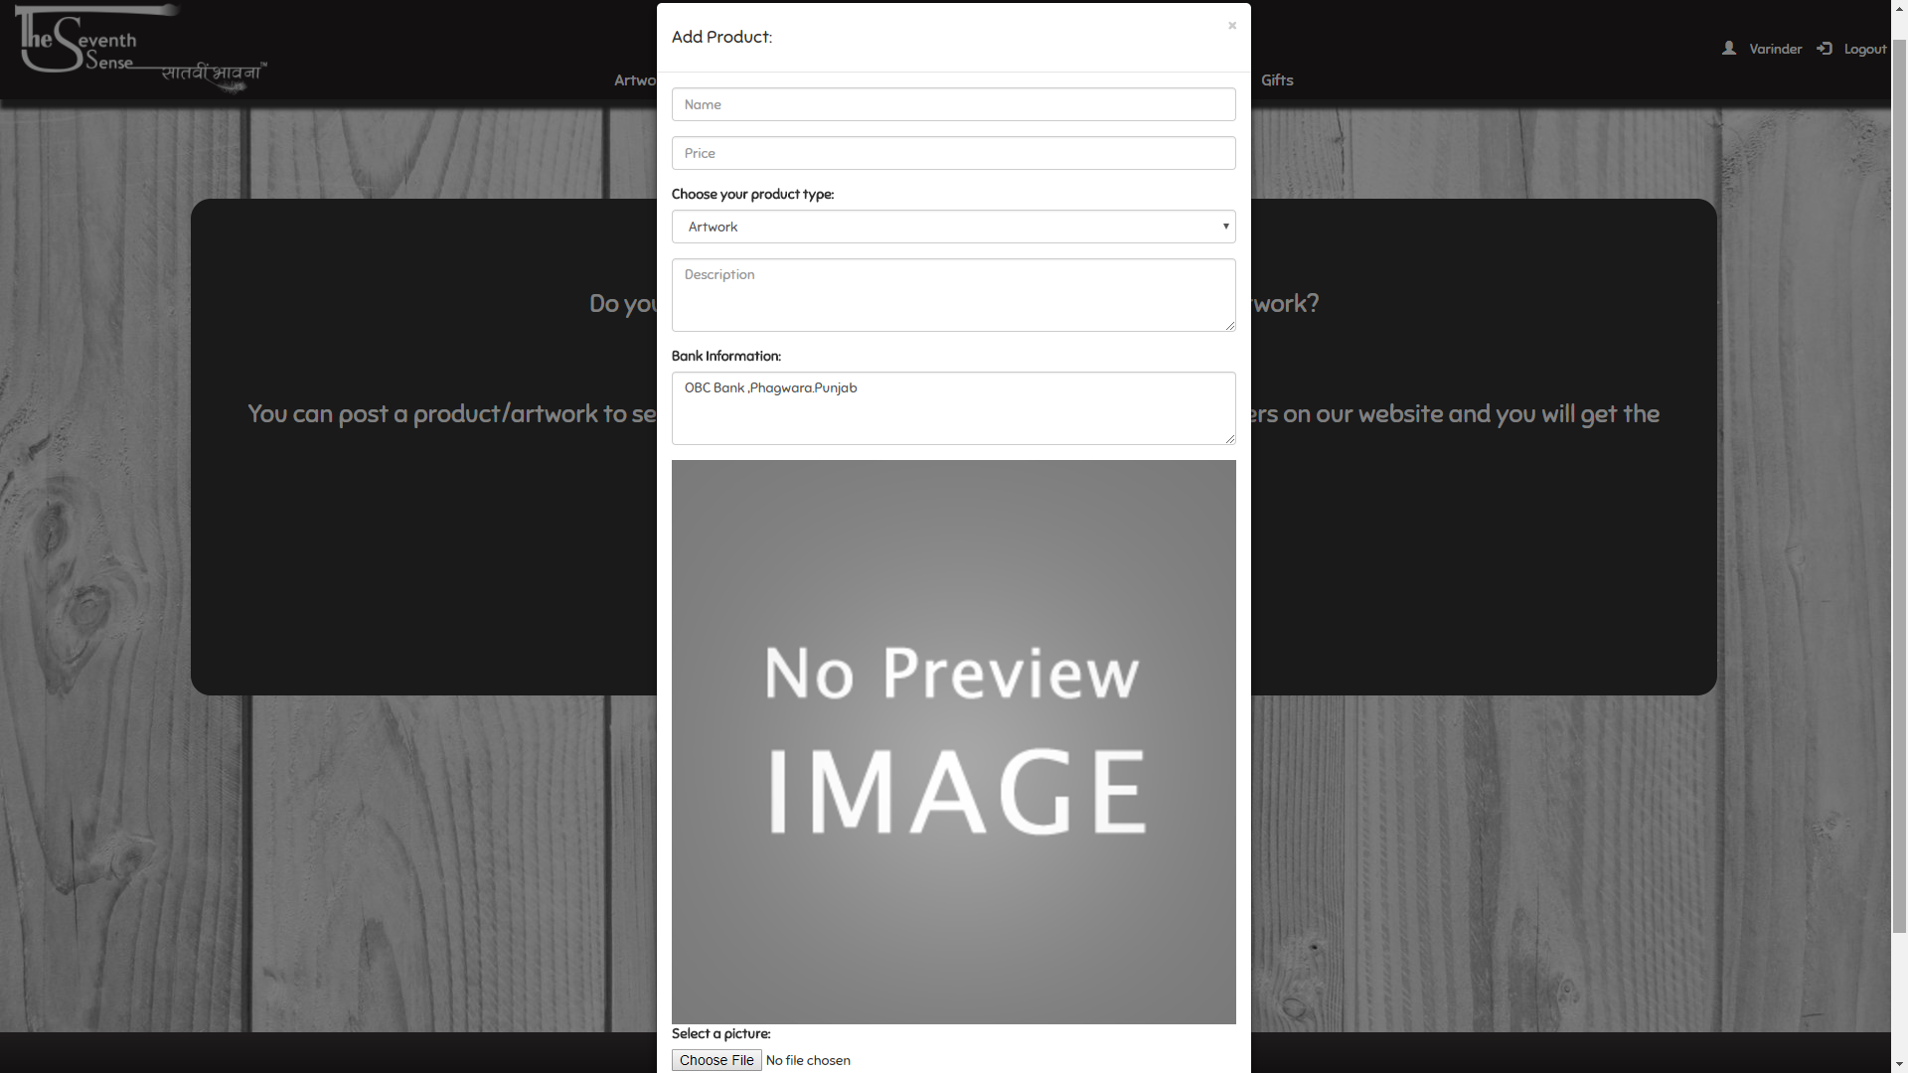
Place your screenshot here
Post
Product
Form
Sell
Page

Slide 44
Thank You!

